Slide 1
PUSL 2026 - Computer Networks
Lecture 9 – Network Security
Chamara Disanayake
Senior Lecturer
Department of Network and Security

Slide 2
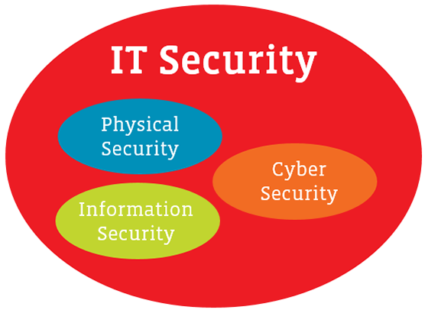
What is Security ?
Late Middle English from Old French securite or Latin securitas, from securus ‘free from care’
Security is freedom from, or resilience against, potential harm (or other unwanted coercive change) caused by others ( Wikipedia).
Protection of a person, building, organization, or country against threats such as crime or attacks by foreign countries: ( Cambridge ).
It’s the sensation /feeling or the state of being free from danger or threat
What is IT Security
IT security is a cybersecurity strategy that prevents unauthorized access to organizational assets including computers, networks, and data.

Slide 3
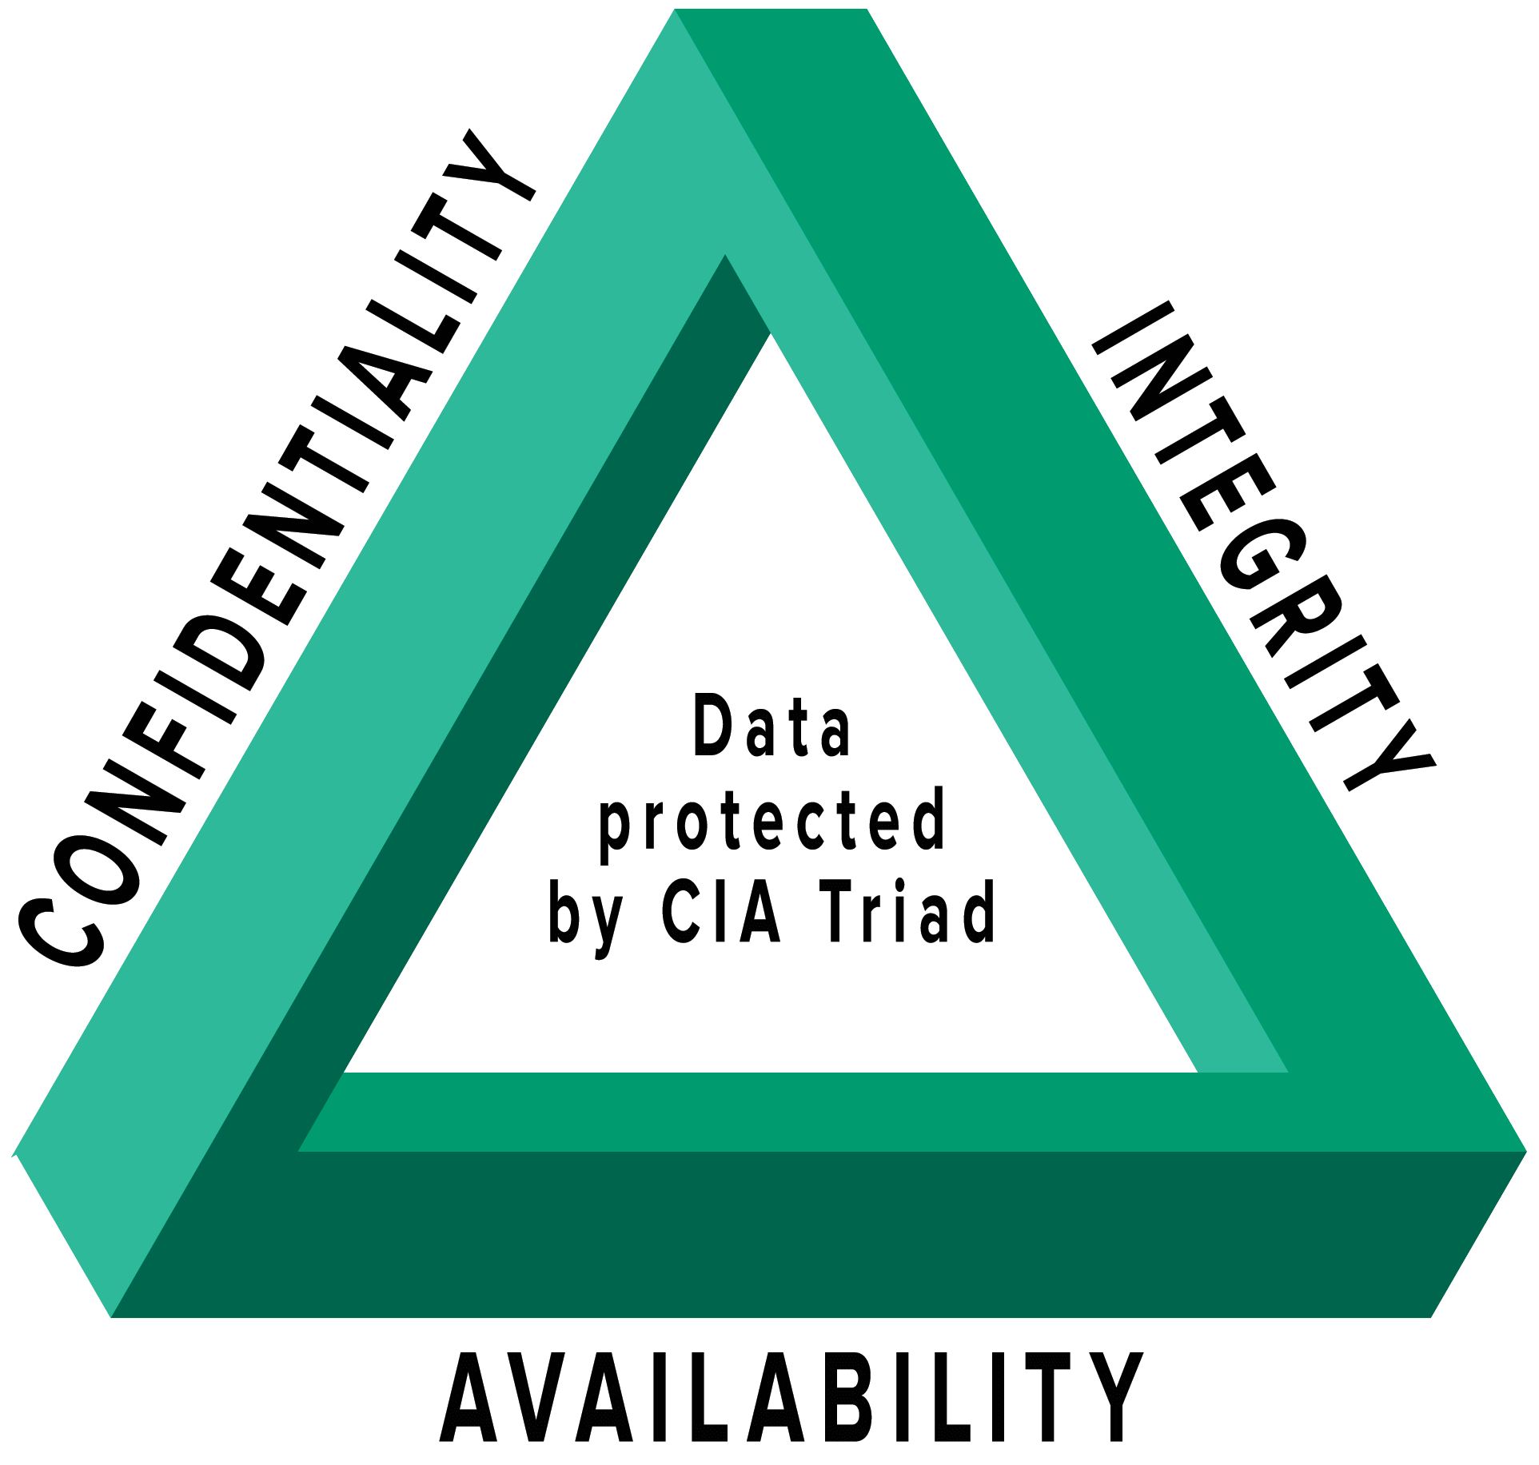
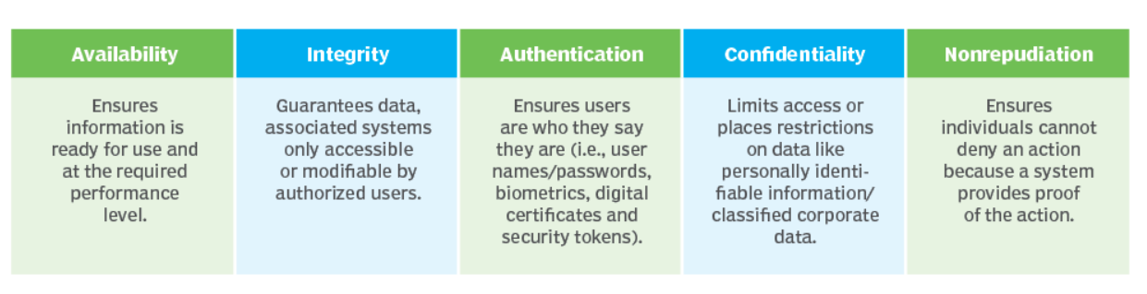
Main Objectives of IT Security
To Provide
Confidentiality
Integrity
Availability
for the data and systems implemented over IT infrastructure
This is called the CIA triad which is the model that forms the basis for the development of security systems.

Slide 4
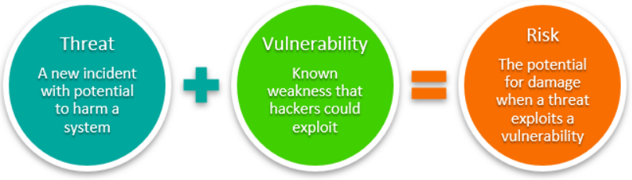
How We Provide IT Security?
Focused on the threats
Threat Detection
Identify the methods to counter them.
Technology Awareness
Select the appropriate technique to get the result.
Selection and Implementation
Check the effectiveness of the applied security measures periodically.
Testing and Maintenance

Slide 5
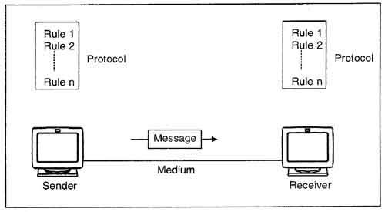
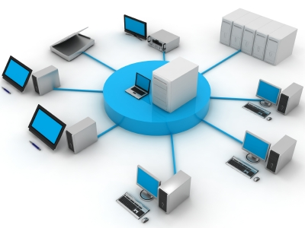
Network Security
Network plays a major role in IT infrastructure
Main Components of data communication
Network consists with several physical and digital components including human resources
Hardware and communication media
Data and information
Liveware

Slide 6

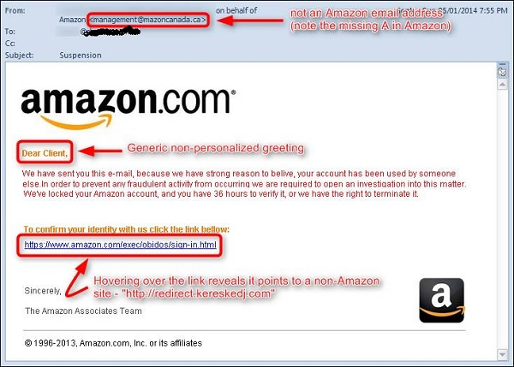
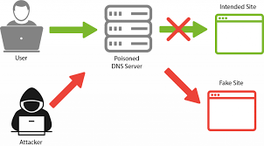
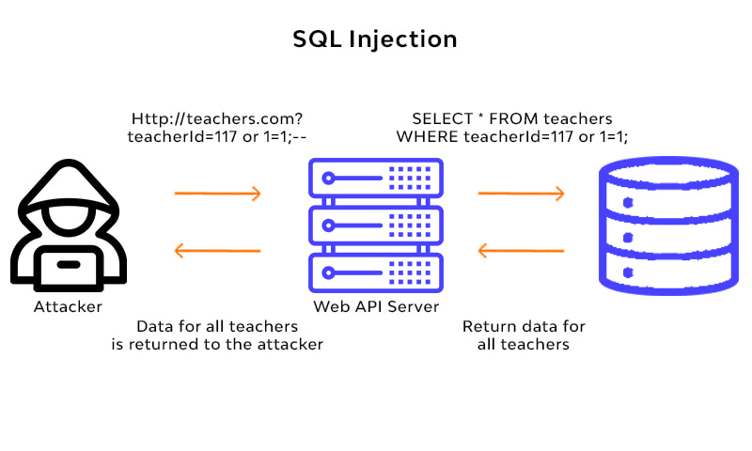
Attacks for the Network Services
Experience of Attacks
Websites Defacements
Email hijacking (phishing, ransomware)
Data leaks (SQL injections, credential leaks)
Redirecting to other sites (DNS spoofing, cross-site scripting XSS)

Slide 7
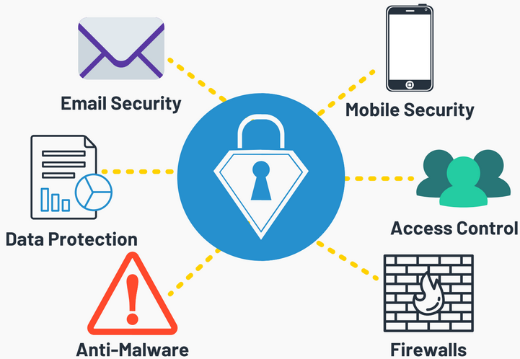
Common Factors in Network Attacks
All attacks affects the users' credibility, organizational reputation, suffer financial losses, unavailability of services
Some attacks are on the IT components, and some are on the media (“Network”)
Here we are mainly discussing the attacks and prevention mechanism on the networks but we focus on the all components in the OSI architecture”

Slide 8
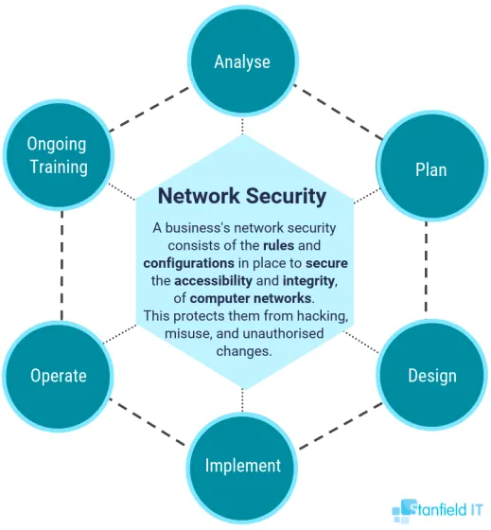
Network Security
Network security
consists of the
policies, processes and practices
adopted to
monitor, detect and prevent unauthorized access, misuse, modification, or denial
of a
computer network and network-accessible resources.

Slide 9
Threats and Attacks
Threat is a possible security violation that might exploit the vulnerability of a system or asset. The origin of threat may be accidental, environmental (natural disaster), human negligence or human failure.
Attack is a deliberate unauthorized action on a system or asset. Attack can be classified as active and passive attack. An attack will have a motive and will follow a method when opportunity arise.
Security threats/attacks can be in the form of interception, interruption, fabrication and modification.

Slide 10
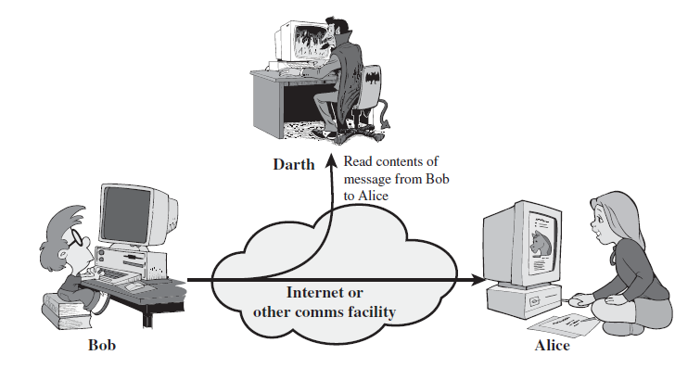
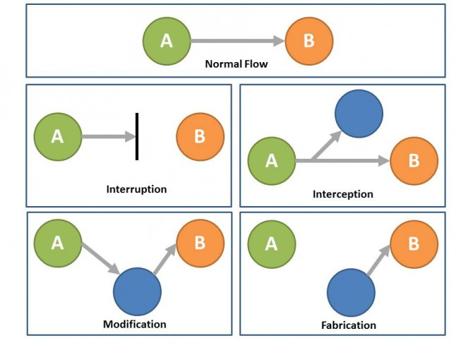
Passive Attacks
In Passive attack, an attacker observes the messages, copy them and may use them for malicious purposes – Interception
Intruding and monitoring of information is the main motive behind a Passive attack.
In a passive attack the attacker looks out for open ports and network vulnerabilities and gains access to it as soon as it detects one.
Passive attacks are difficult to detect

Slide 11
Active Attacks
In Active attack, an attacker tries to modify the content of the messages.
Interruption, modification, and fabrication are few forms of an Active attack.
Interruption: Usually known as a masquerade attack, in there the attackers pose themselves as a legal entity to trick victims.
Modification: This involves multiple series of replay and alterations. The original sequence of the data sent is captured and resend, it also involves alteration of the original message.
Fabrication: prevents the users from accessing certain services, It is normally termed as Denial of services where the hackers gain unauthorized access to the servers and block users’ access.

Slide 12
Network Threats/Attacks Target to Data Flow
Network Threats affects the normal flow of the data communication between the source and the destination
Interruption: Usually known as a masquerade attack, in there the attackers pose themselves as a legal entity to trick victims.
Modification: This involves multiple series of replay and alterations. The original sequence of the data sent is captured and resend, it also involves alteration of the original message.
Fabrication: prevents the users from accessing certain services, It is normally termed as Denial of services where the hackers gain unauthorized access to the servers and block users’ access.

Slide 13
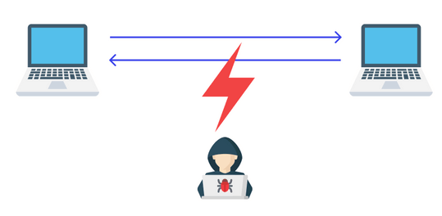
Passive Attack - Prevent interception
Example:
Eavesdropping
act of secretly or stealthily listening to the private conversation or communications of others without their consent in order to gather information.
Prevention Methods
SSL
Lockdown physical access to ports based on MAC or RADIUS authentications.
Secure the communication through SSL
Using VPN tunnels.
Securing the communication path.
Firewalls and IDS/IPS to keep Intruders away from the network.
Multistage and multifactor authentications to verify valid user.

Slide 14
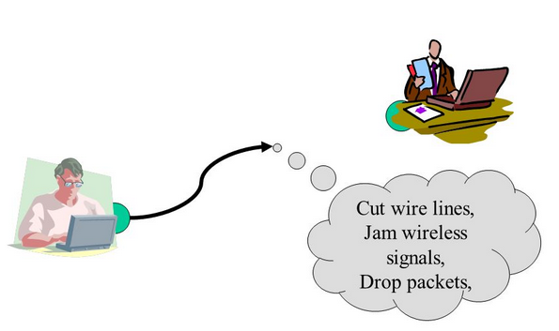
Preventing Interruptions
Interruption
a network outage that results in a temporary unavailability or temporary curtailment of supply to a customer by the relevant network Securing the network devices and configurations.
Prevention Methods
Redundancy of devices to avoid single point of failures
Firewalls and IPS to prevent DOS and DDOS attacks.
Enhance routing protocols to maintain multiple paths.
Load balancers in front of Application servers.
Link load balancers to manage multiple ISP links
Maintain Backups ,locking config files using NMS

Slide 15
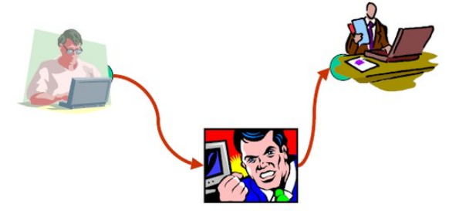
Prevent Modification
Modification is an attack against the integrity of the information. Basically, there is three types of modifications.
Change, Insertion, Deletion
Mitigation Techniques
Hashing methods.
Encryption.
Locking and archiving old Data - Backup
Access and privilege control over Data.
Message Authentication Codes (MACs).

Slide 16
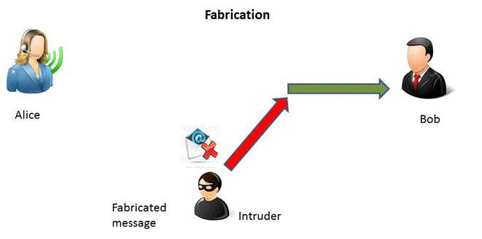
Prevent Fabrication
Fabrication: prevents the users from accessing certain services, It is normally termed as Denial of services where the hackers gain unauthorized access to the servers and block users’ access.
SQL injection, E-mail spoofing
Methods
Digital certificates to verify the origins
Hashing to Identify the Original.
Message Authentication Codes (MACs).

Slide 17
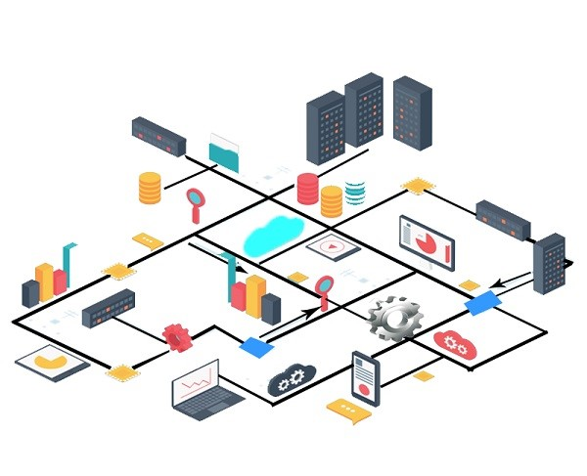
What to be Secure in the Network
To prevent such attacks, then network should be secured in many ways
In enterprise network you needs to secure everything
All information assets.
Physical assets.
Human assets.
As the Network plays a Major role in all the above.

Slide 18
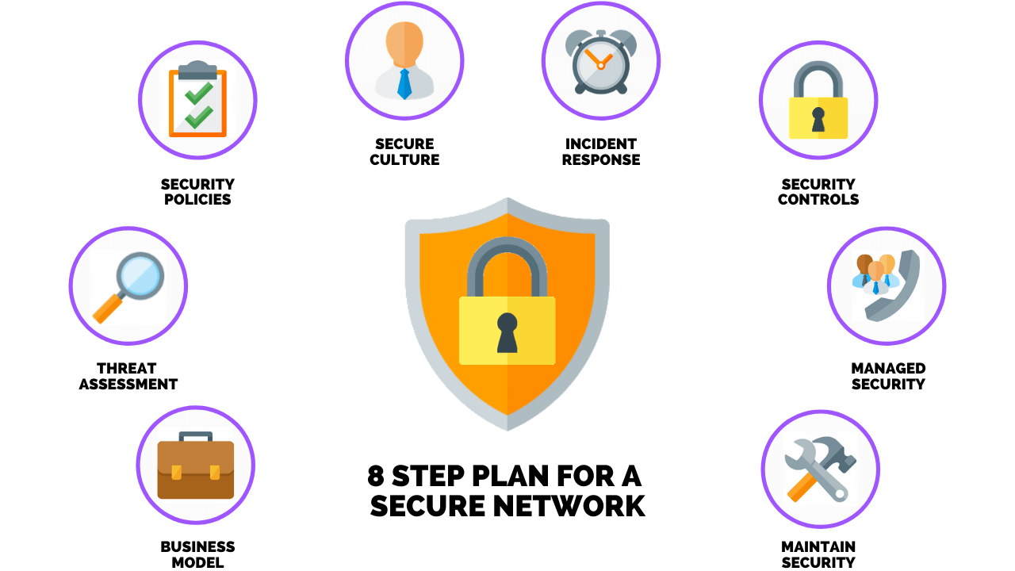
How we do it on the network
It’s a collective approach on every level.
Needs a setup a complete eco system.
Policy plays a major role but none technical.
In general, a policy will enable you to role which to be implement as a technical solution.
The common types of network security include Network Access Control, IT Security Policies, Application Security, Vulnerability Patch Management, Network Penetration Testing, Data Loss Prevention, Antivirus Software, Endpoint Detection And Response (EDR), Email Security, Wireless Security, IDS/IPS, Network Segmentation

Slide 19
Process of Implementation of Security
Identify security Risks Threats
Example:
It has been identified BYOD is a risk but reduce the IT resource cost of the organization
Define the security enhancement procedure for BYOD
Policy to be agreed as principal by Management
Define the rule /guideline and best practice in align with the policies
Hardware and software implemented and enforced to protect the network resources

Slide 20
What do We Have – Total Solution
Needs to secure entry exits (firewalls).
Needs to secure all hosts (End level security)
Make sure the required individuals have access to the secured information ( Access control)
Need spy to report back the intrusions and block it (IPS/IDS).
Needs to register the known (Digital Signatures, PKI ).
Needs to send information in secure and secretly (Encryption and Steganography ).
Need security for remote accesses (VPNs and SSL/TLS)
Write all the movements( logs)

Slide 21
Technologies
Firewalls.
IPS & IDS, end point security.
Encryption ( cryptography and steganography ).
Digital signatures, PKI
Central user authentication LADP, AD ,RADIUS.

Slide 22
Firewalls

Slide 23

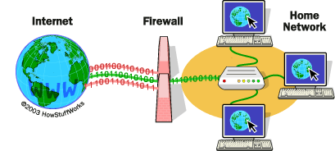
Firewall
An ancient technology for defend from enemy.
Very effective for gateway or excites.
First line of defense in the perimeter.
Focus to segregate the network based on security risk or protection level and filter in and out traffic.

Slide 24
Firewall History - Evolution
First generation: packet filters
Digital Equipment Corporation (DEC) developed filter systems known as packet filter firewalls.
Second generation: stateful filters
AT&T Bell Laboratories developed the second generation of firewalls, calling them circuit level firewalls.
Third generation: application layer filters
Integrating identity of users into Firewall rules
Fourth generation: NGFW proactive tools that use machine learning to enforce security policies.
In 2008, Palo Alto Networks delivered the industry’s first next-generation firewall (NGFW)
From Packet Filtering to Machine Learning-Powered NGFWs. Firewalls have evolved from reactive devices that control access to internal resources to proactive tools that use machine learning to enforce security policies.

Slide 25
Firewall Types
Firewalls are traditionally inserted inline across a network connection and look at all the traffic passing through that point. As they do so, they are tasked with telling which network protocol traffic is benign and which packets are part of an attack.
Firewall Types
Packet filtering firewall
Circuit-level gateway
Application-level gateway (aka proxy firewall)
Stateful inspection firewall
Next-generation firewall (NGFW)

Slide 26
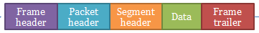
Packet filters
Packets examined at the network layer
Source IP, Destination IP etc
Useful “first line” of defense - commonly deployed on routers
Simple accept or reject decision model
No awareness of higher protocol layers
Applications
Applications
Applications
Presentations
Presentations
Presentations
Sessions
Sessions
Sessions
Transport
Transport
Transport
Network
Network
Network
Data Link
Data Link
Data Link
Physical
Physical
Physical

Slide 27
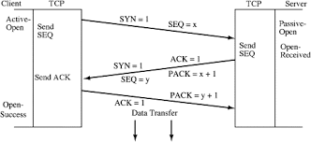
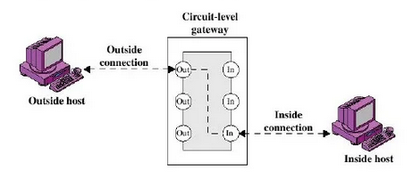
Circuit Level Gateways
Circuit-level gateways essentially operate at a higher level of the OSI model protocol stack than network-level firewalls do
Circuit-level gateways monitor TCP handshakes and other network protocol session initiation messages across the network as they are established between the local and remote hosts to determine whether the session being initiated is legitimate
Imposes security by limiting which such connections are allowed
Once created usually relays traffic without examining contents.
Typically used when trust internal users by allowing general outbound connections

Slide 28
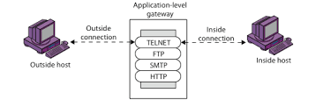
Application-level gateways
Sometimes referred to as a proxy firewall
Functions as the only entry point to and exit point from the network.
Application-level gateways filter packets not only according to the service for which they are intended, but also by other characteristics, such as the HTTP request string.
Application-layer firewalls are best used to protect enterprise resources from web application threats.
They can both block access to harmful sites and prevent sensitive information from being leaked from within the firewall.
They can, however, introduce a delay in communications.

Slide 29
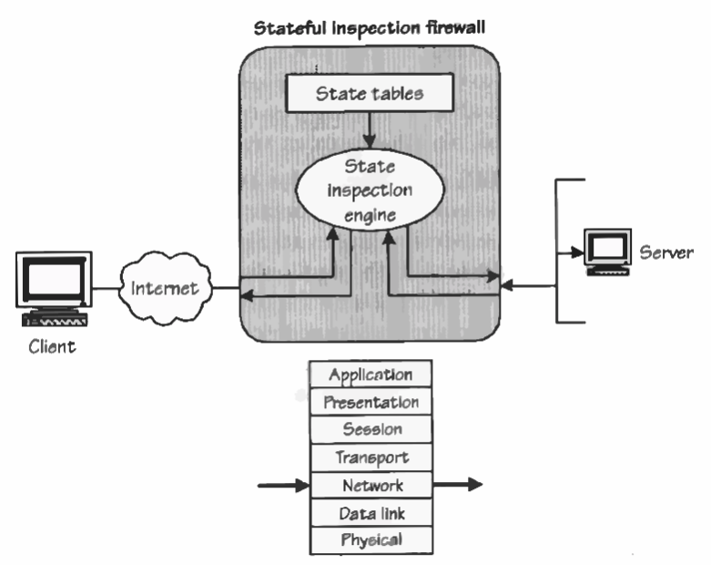
Stateful Inspection firewall
Stateful firewall deals with connections and their characteristics rather than packets individually.
State-aware devices not only examine each packet, but also keep track of whether or not that packet is part of an established TCP or other network session.
This offers more security than either packet filtering or circuit monitoring alone but affects the network performance.
They also can be highly effective in defending network devices against particular attacks, such as DoS.

Slide 30
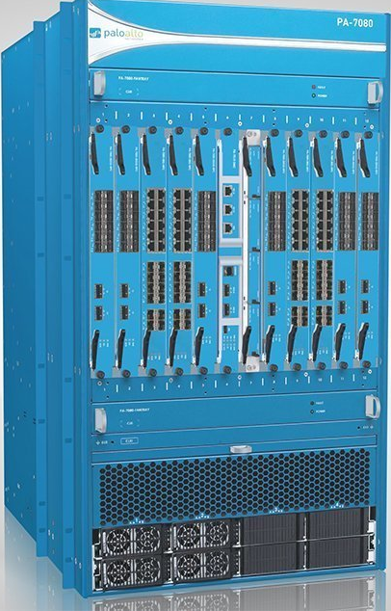
Next-generation Firewall
A typical NGFW combines packet inspection with stateful inspection and also includes some variety of deep packet inspection (DPI), as well as other network security systems, such as an IDS/IPS, malware filtering and antivirus.
While packet inspection in traditional firewalls looks exclusively at the protocol header of the packet, DPI looks at the actual data the packet is carrying. A DPI firewall tracks the progress of a web browsing session and can notice whether a packet payload, when assembled with other packets in an HTTP server reply, constitutes a legitimate HTML-formatted response.
Advantages of NGFW
Combines DPI with malware filtering and other controls to provide an optimal level of filtering
Tracks all traffic from Layer 2 to the application layer for more accurate insights than other methods
Can be automatically updated to provide current context
NGFW disadvantages
In order to derive the biggest benefit, organizations need to integrate NGFWs with other security systems, which can be a complex process
Costlier than other firewall types

Slide 31
Firewall Delivery Methods
Firewalls today can be deployed as a hardware appliance, be software-based or be delivered as a service.
Hardware-based firewalls
A hardware-based firewall is an appliance that acts as a secure gateway between devices inside the network perimeter and those outside it.
Because they are self-contained appliances, hardware-based firewalls don't consume processing power or other resources of the host devices.
Sometimes called network-based firewalls, these appliances are ideal for medium and large organizations looking to protect many devices.
Hardware-based firewalls require more knowledge to configure and manage than their host-based counterparts

Slide 32
Software-based firewalls
A software-based firewall, or host firewall, runs on a server or other device.
Host firewall software needs to be installed on each device requiring protection.
As such, software-based firewalls consume some of the host device's CPU and RAM resources.
Software-based firewalls provide individual devices significant protection against viruses and other malicious content.
Cloud/hosted firewalls
Managed security service providers (MSSPs) offer cloud-based firewalls.
This hosted service can be configured to track both internal network activity and third-party on-demand environments.
Also known as firewall as a service, cloud service model

Slide 33
Firewall Deployment Architectures
Screening Router
Simple Firewall
Multi-Legged firewall
Firewall Sandwich
Layered Security Architecture

Slide 34
Screening Router
Access Lists provide security - ACL
Routers are not application aware
Only inspects network level information
Layer 3 of the OSI model
Does not provide a great deal of security
Very fast
Not commonly used alone for security

Slide 35
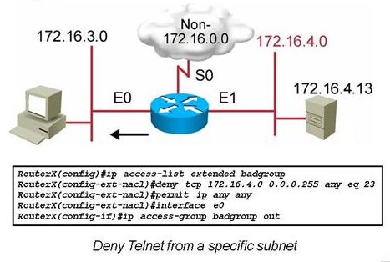
ACL Example
Block specific communication
The “badgroup” named extended ACL will deny all telnet requests initiating on subnet 172.16.4.0 going out on E0 to subnet 172.16.3.0.
All other traffic will be permitted. The ACL is applied in the outbound direction on interface E0.

Slide 36
Simple Firewall
Small Companies with limited security needs
Only utilizes two interfaces
Trusted
Un-trusted
Provides modest security
Does not offer dmz sandbox
Inherently allows some level of connections between trusted and un-trusted networks

Slide 37
Multi-Legged Firewall
Small to large sized business
Security need is expanded
Provides stronger security
Creates a secure sandbox for semi-trusted services
Flexible and secure

Slide 38
Firewall Sandwich
Medium to large businesses
Higher costs
More serious need for security
Provides a physical separation of networks
Provides policy segregation between inside and outside firewalls
Reduces administrative holes

Slide 39
Layered Firewall Approach
Large enterprises with low risk tolerance
Separates internal environments
Reduces computer crimes
Most attacks are internally based
Deters malicious activities
Controls overhead administrative traffic
Allows IDS to work more effectively

Slide 40
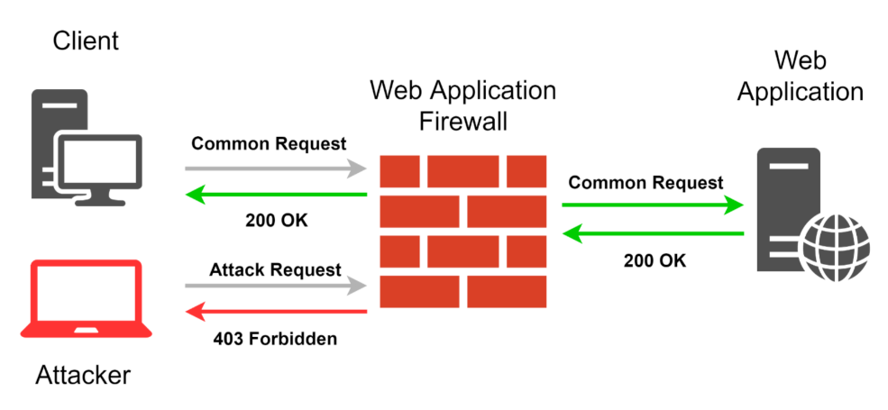
Other Types of Firewalls
WAF – Web Application Firewalls
A web application firewall (WAF) is a specific form of application firewall that filters, monitors, and blocks HTTP traffic to and from a web service
By inspecting HTTP traffic, it can prevent attacks exploiting a web application's known vulnerabilities, such as SQL injection, cross-site scripting (XSS), file inclusion, and improper system configuration.

Slide 41
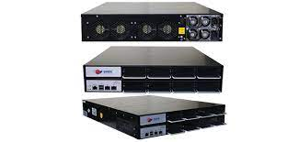
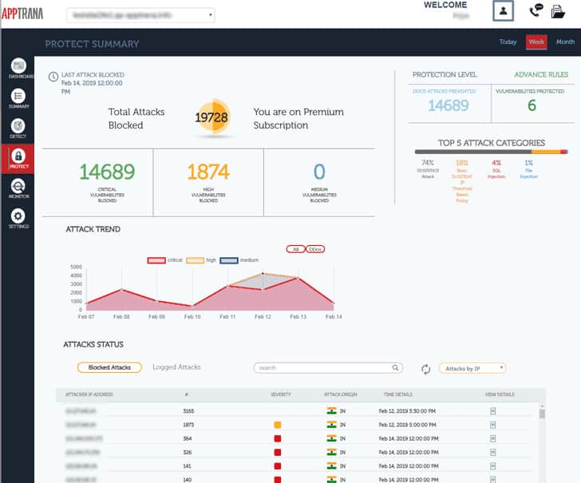
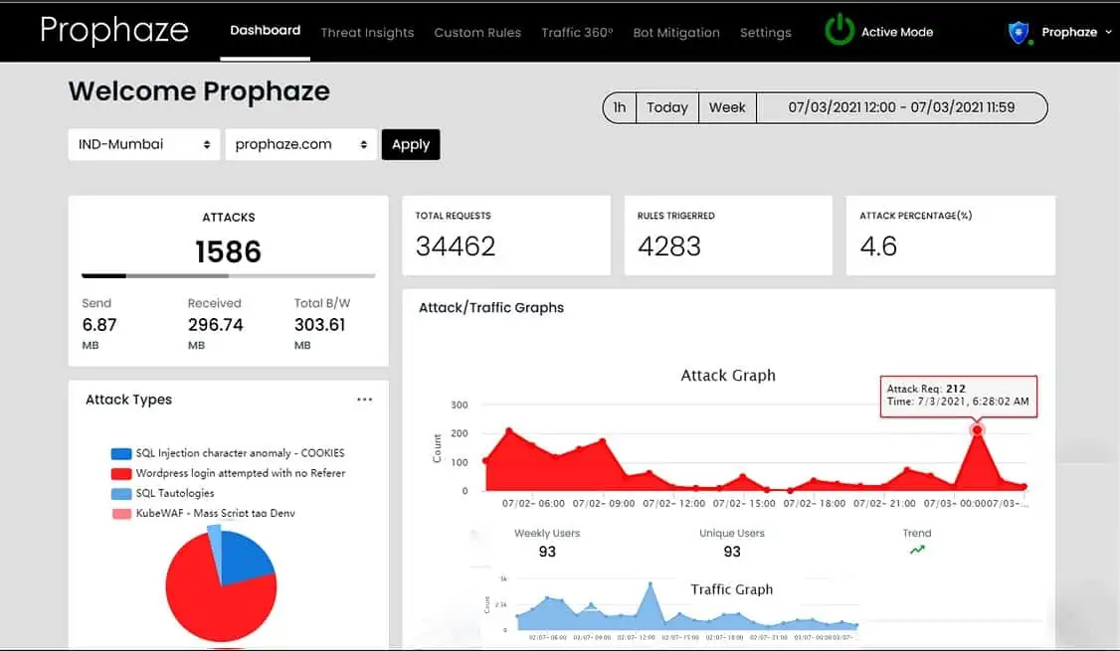
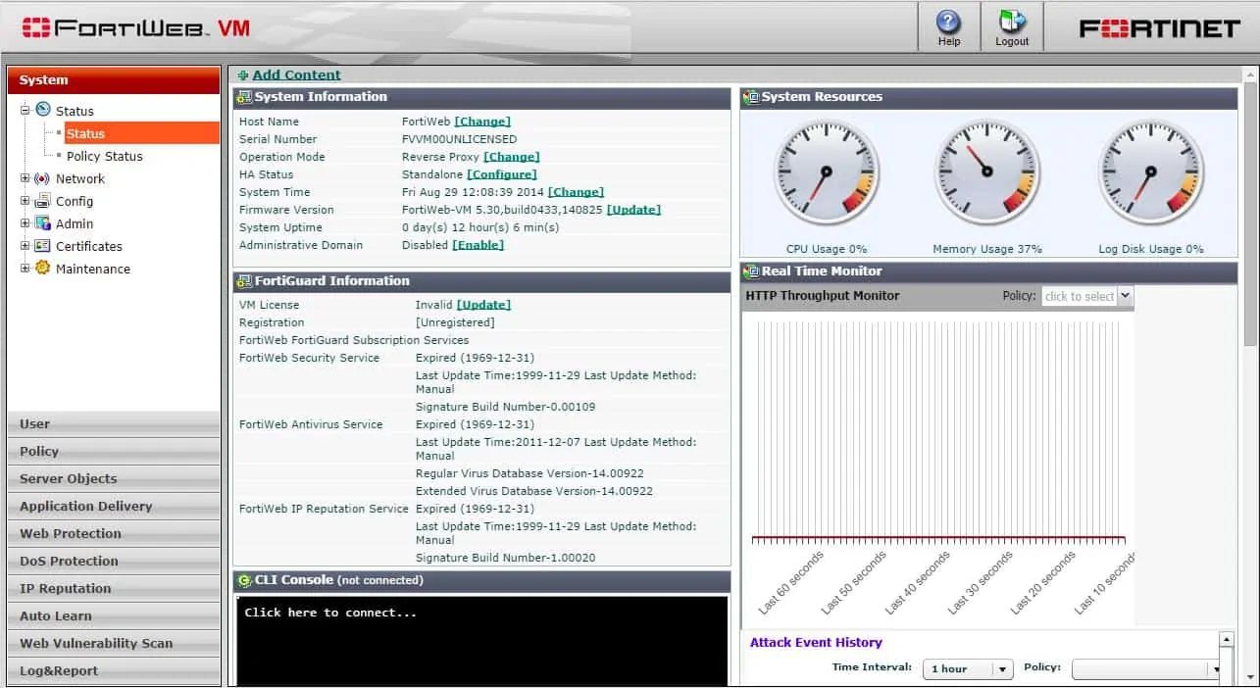
WAF
While proxies generally protect clients, WAFs protect servers. A WAF is deployed to protect a specific web application or set of web applications. A WAF can be considered a reverse proxy.
WAFs may come in the form of an appliance, server plugin, or filter, and may be customized to an application. The effort to perform this customization can be significant and needs to be maintained as the application is modified.

Slide 42
Current and Future of Firewalls
Capability of having multiple zones.
Very high throughput.
Unification of security servicers.
Online threat update and notification.
Self learning – AI?
Layer 7 application and content-based filtering.
Individual user behavior recognition and response.

Slide 43
IDS & IPS

Slide 44

Intrusion and Intrusion Detection
Intrusion : Attempting to break into or misuse your system.
Intruders may be from outside the network or legitimate users of the network.
Intrusion can be a physical, system or remote intrusion.
It is important to detect and prevent such intrusions as it affects the CIA of the network systems.

Slide 45
Intrusion Detection System
An Intrusion Detection System (IDS) is a device or software application that monitors network or system activities for malicious activities or policy violations and produces reports to a Management Station.
It is a passive device/process as it does not affect the incoming packets
primarily focused on identifying possible incidents, logging information about them, and reporting attempts.
Reporting is important as the prevention needs to be done intentionally.
Reporting can be Alerts, Alarms, SMS, Email or auto generated calls

Slide 46
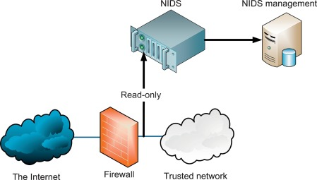
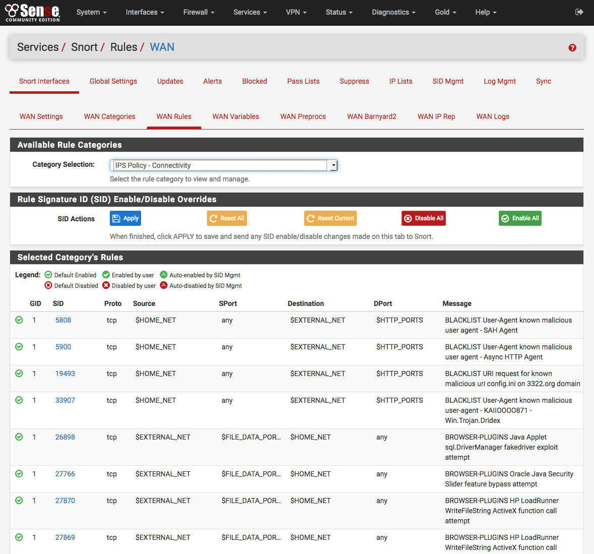

IDS types
Network intrusion detection system (NIDS)
is an independent platform that identifies intrusions by examining network traffic and monitors multiple hosts
IDS access to network traffic by connecting to a network hub, network switch configured for port mirroring, or network tap. In a NIDS, sensors are located at choke points in the network to be monitored, often in the (DMZ) or at network borders.
An example of a NIDS is Snort.

Slide 47
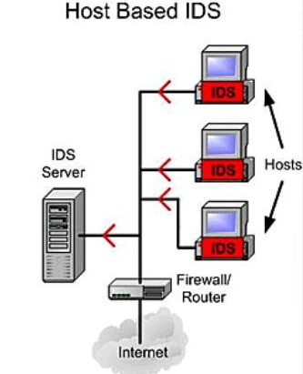
IDS types
Host-based intrusion detection system (HIDS)
An agent on a host that identifies intrusions by analyzing system calls, application logs, file-system modifications (binaries, password files, capability databases, Access control lists, etc.) and other host activities and state.
Examples of HIDS are Tripwire and OSSEC.
Stack-based intrusion detection system (SIDS)
The packets are examined as they go through the TCP/IP stack and its implementation to be dependent on the Operating System that is being used.

Slide 48
Intrusion Prevention System
An intrusion prevention system (IPS) is a form of network security that works to detect and prevent identified threats.
Intrusion prevention systems continuously monitor the network, looking for possible malicious incidents and capturing information about them.
Similar to IDS – IPS is also having IDS capabilities and know and Intrusion Detection and Prevention System
Intrusion prevention systems control the access to an IT network and protect it from abuse and attack.
IPSs combine IDSs and improved firewall technologies, they make access control decisions based on application content, rather than IP address or ports like a traditional firewalls

Slide 49
How IPS Works
The IPS performs real-time packet inspection, deeply inspecting every packet that travels across the network.
If any malicious or suspicious packets are detected, the IPS will carry out one of the following actions:
Terminate the TCP session that has been exploited and block the offending source IP address or user account from accessing any application, target hosts or other network resources unethically.
Reprogram or reconfigure the firewall to prevent a similar attack occurring in the future.
Remove or replace any malicious content that remains on the network following an attack. This is done by repackaging payloads, removing header information and removing any infected attachments from file or email servers.

Slide 50
IPS – How to Detect Intrusions
An intrusion prevention system is typically configured to use several different approaches to protect the network from unauthorized access.
These include:
Signature-Based - The signature-based approach uses predefined signatures of well-known network threats. When an attack is initiated that matches one of these signatures or patterns, the system takes necessary action.
Anomaly-Based - The anomaly-based approach monitors for any abnormal or unexpected behavior on the network. If an anomaly is detected, the system blocks access to the target host immediately.
Policy-Based - This approach requires administrators to configure security policies according to organizational security policies and the network infrastructure. When an activity occurs that violates a security policy, an alert is triggered and sent to the system administrators.

Slide 51
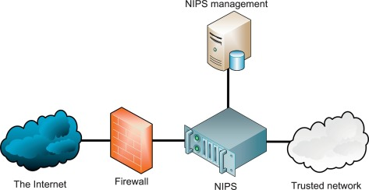
IPS - Types
Network-based intrusion prevention system (NIPS):
It monitors the entire network for suspicious traffic by analyzing protocol activity.
Wireless intrusion prevention system (WIPS):
It monitors a wireless network for suspicious traffic by analyzing wireless networking protocols.
Network behavior analysis (NBA):
It examines network traffic to identify threats that generate unusual traffic flows, such as distributed denial of service attacks, specific forms of malware and policy violations.
Host-based intrusion prevention system (HIPS):
It is an inbuilt software package which operates a single host for doubtful activity by scanning events that occur within that host.

Slide 52
Comparison of IPS with IDS:
The main difference between Intrusion Prevention System (IPS) with Intrusion Detection Systems (IDS) are:
Intrusion prevention systems are placed in-line and are able to actively prevent or block intrusions that are detected.
IPS can take such actions as sending an alarm, dropping detected malicious packets, resetting a connection or blocking traffic from the offending IP address.
IPS also can correct cyclic redundancy check (CRC) errors, defragment packet streams, mitigate TCP sequencing issues and clean up unwanted transport and network layer options.

